Slide 1
Introduction to Kotlin
https://kotlinlang.org

Slide 2
Part-I Introduction
Kotlin
Kotlin Philosophy
How to use Kotlin

Slide 3
Kotlin
General-purpose programming language
Statically typed and compiled programming language
It is Open Source (Apache 2.0) project
Developed by JetBrains

Slide 4
Kotlin Philosophy
Readability: is a primary goal in the design of the language
Multi-Paradigm: Kotlin supports multiple programming paradigms
Imperative programming
Functional programming
Object-oriented programming

Slide 5
Kotlin Philosophy
Concise: Drastically reduce the amount of boilerplate code
Create a POJO with getters, setters, equals(), hashCode(), toString() and copy() in a single line:
Filter a list using a lambda expression:

Slide 6


Kotlin Philosophy
Safe: Avoid entire classes of errors such as null pointer exception
Get rid of NullPointerExceptions
Kotlin protects you from mistakenly operating on nullable types

Slide 7
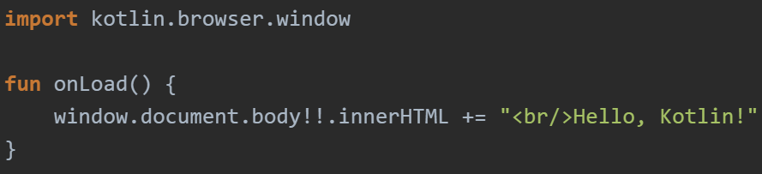
Kotlin Philosophy
Interoperable: Leverage existing libraries for JVM, Android and the Browser
Write code in kotline and decide where you want to deploy it

Slide 8
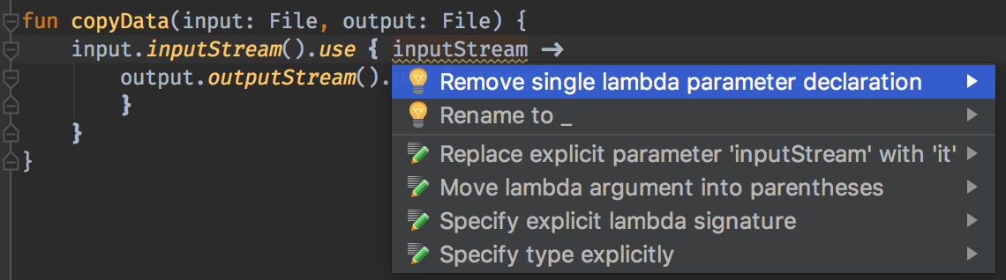
Kotlin Philosophy
Tool-Friendly: Choose any Java IDE or build from the command line

Slide 9

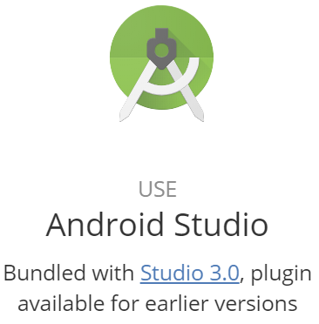

How to use Kotlin

Slide 10
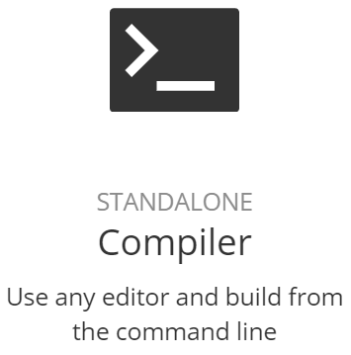
How to use Kotlin
Downloading the compiler
Manual Install: Download and unzip the standalone compiler
SDKMAN!
$ curl -s https://get.sdkman.io | bash
$ sdk install kotlin
Snap package
$ sudo snap install --classic kotlin
https://kotlinlang.org/docs/tutorials/command-line.html

Slide 11
How to use Kotlin
Compiling and Running Kotlin application (CMD)
Write your Kotlin code in a file (.kt) (e.g. hello.kt)
Compile the application using the Kotlin compiler
$ kotlinc hello.kt -include-runtime -d hello.jar
Run the application
$ java -jar hello.jar
https://kotlinlang.org/docs/tutorials/command-line.html

Slide 12
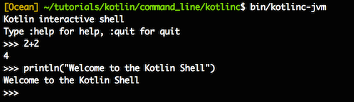
How to use Kotlin
Running the REPL (Read-Eval-Print Loop)
We can run the compiler without parameters to have an interactive shell
https://kotlinlang.org/docs/tutorials/command-line.html

Slide 13
PART-II Basic
Hello World in Kotlin
Packages and Functions
Variables and Comments
Control structures
Exceptions
Extension functions

Slide 14
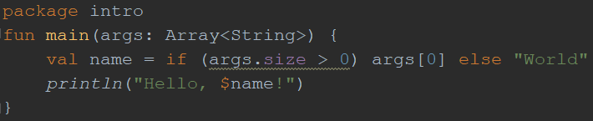
Hello World in Kotlin

Slide 15
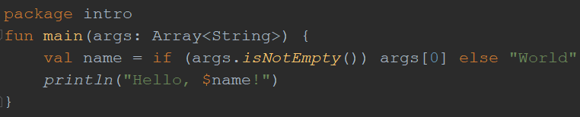
Hello World in Kotlin
Observation
No class definition
You can define functions at the top level
if is an expression not a statement
String template
Easy way of accessing variable values inside string literals
No semicolon is required

Slide 16

Define Packages
It is not required to match directories and packages: source files can be placed arbitrarily in the file system.

Slide 17
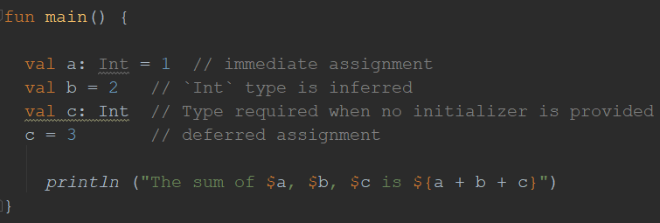
Variables
Use keyword val to define read-only (immutable) variables. They can be assigned a value only once

Slide 18
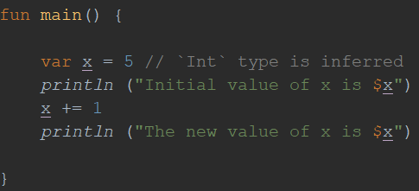
Variables
Use keyword var to define mutable variables. They can be re-assigned a value

Slide 19
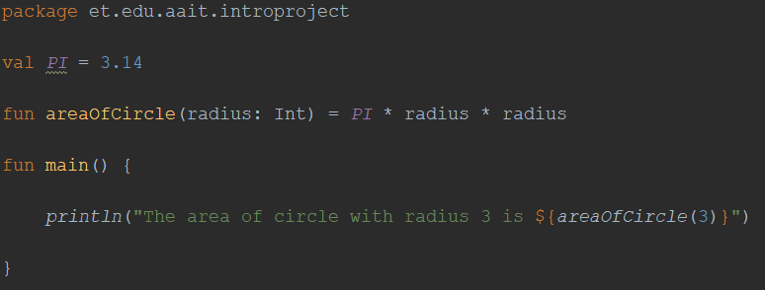
Variables
Top-level variables

Slide 20
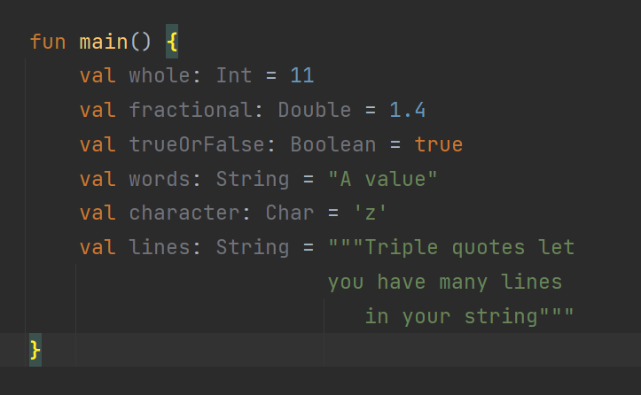
Types
Here are some of Kotlin’s basic types:

Slide 21
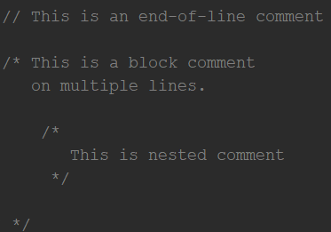
Comments
Just like Java and JavaScript, Kotlin supports end-of-line and block comments.
Unlike Java, block comments in Kotlin can be nested.

Slide 22
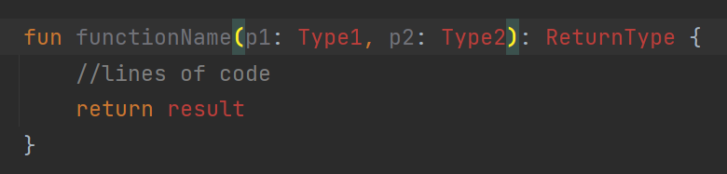
Functions

Slide 23


Functions
Function with an expression body and inferred return type
Use Unit as return type of functions that return no meaningful value
Unit is optional, it can be removed

Slide 24
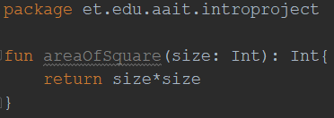
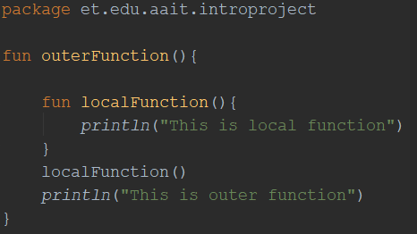
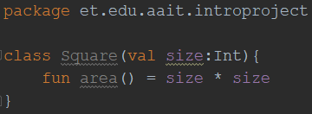
Functions
Top-Level Functions
Member Functions
Local Functions

Slide 25
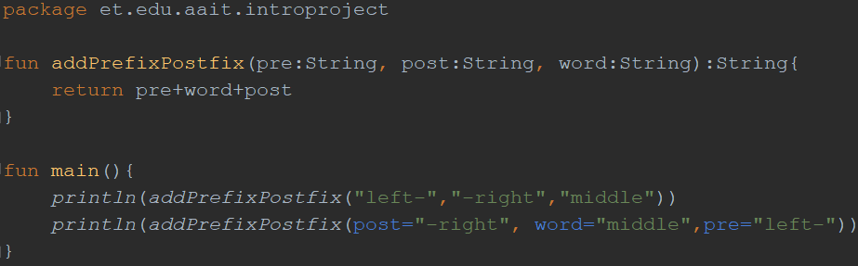
Functions
Named arguments

Slide 26
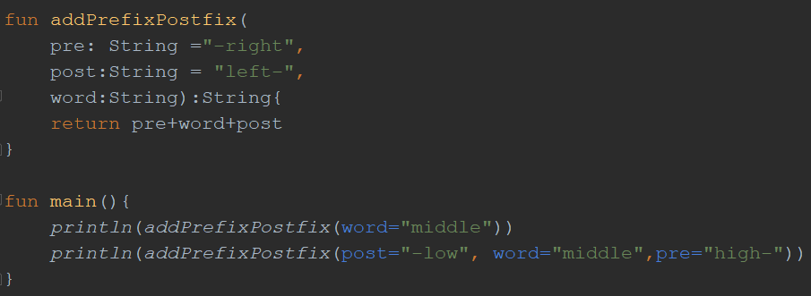
Functions
Default Argument

Slide 27
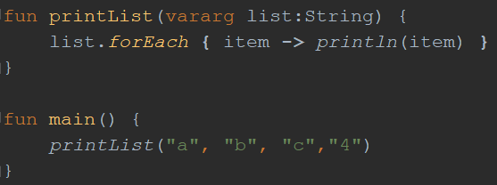
Functions
Variable Arguments

Slide 28


Functions
Function having two Int parameters with Int return type:
Calling sum function from main function

Slide 29
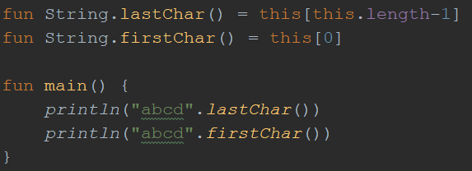
Extension Functions

Slide 30
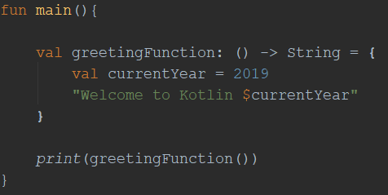
Function Types
A function type definition consists of two parts:
the function’s parameters, in parentheses, followed by
its return type, delimited by the arrow (->)
() -> String tells the compiler what kind of function a variable can hold

Slide 31
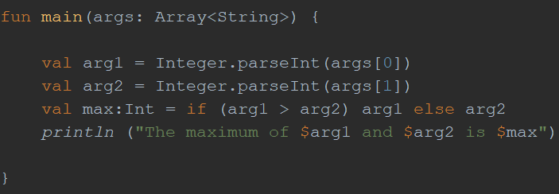
Control structures
Conditionals: if expression
Note that if is an expression not a statement

Slide 32
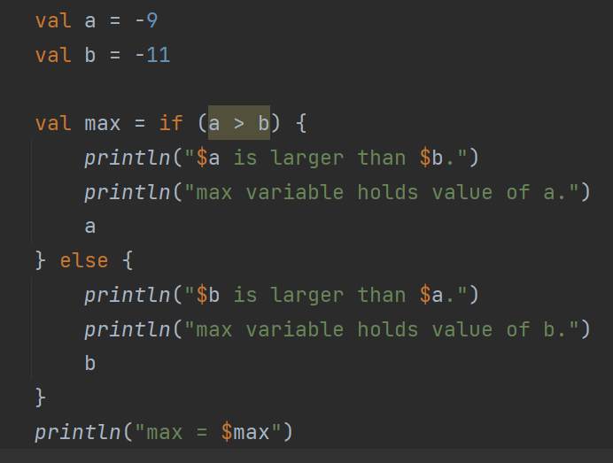
Control structures

Slide 33
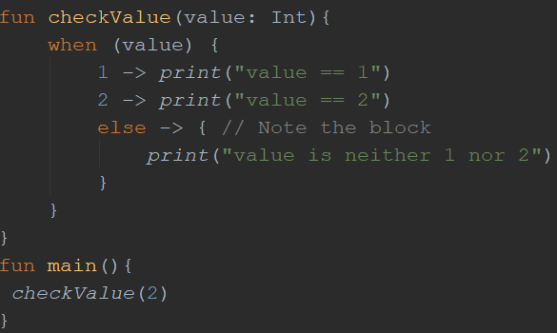
Control structures
Conditionals: when

Slide 34
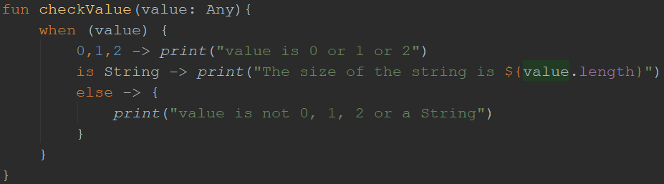
Control structures
Conditionals: when

Slide 35
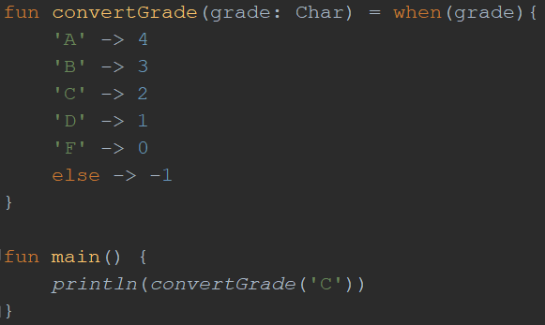
Control structures
Conditionals: when
When is also expression

Slide 36
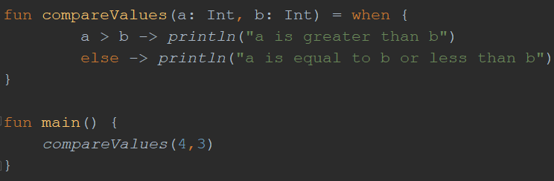
Control structures
Conditionals: when
When without argument

Slide 37
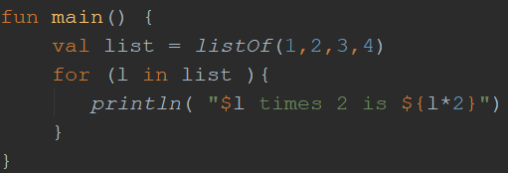
Control structures
Loops: for
5

Slide 38
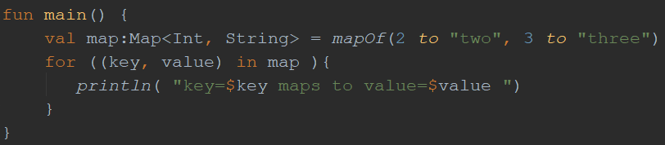
Control structures
Loops: for
5

Slide 39
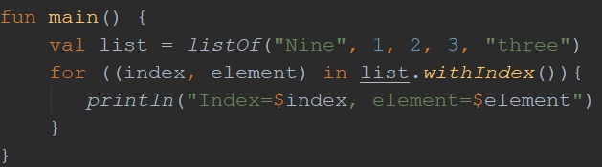
Control structures
Loops: for
5

Slide 40
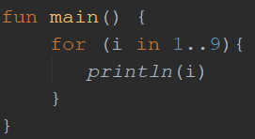
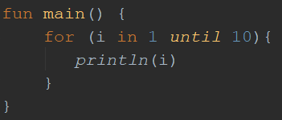
Control structures
Loops: for
Upper bound included
5
Upper bound not included
5

Slide 41
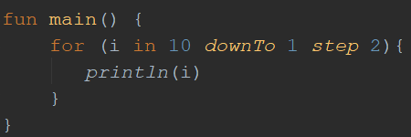
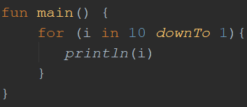
Control structures
Loops: for
Reverse count
5
Reverse count with step value
5

Slide 42
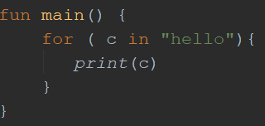
Control structures
Loops: for
Iterating over String
5

Slide 43
Control structures
Note the use of in
it can be used for iteration and also to check belongingness
Iterating over String Checking for belonging
5

Slide 44
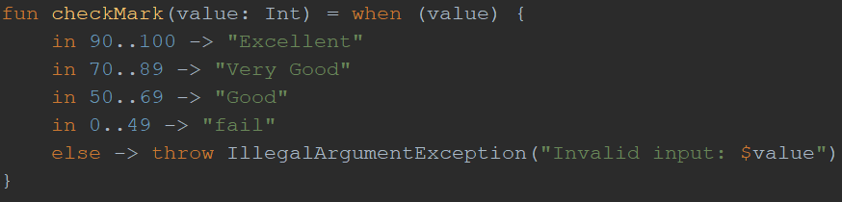
Exceptions
throw is an expression

Slide 45
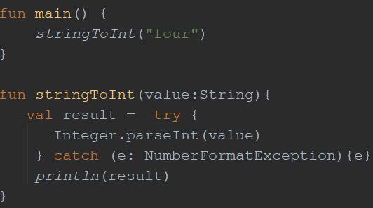
Exceptions
try is an expression

Slide 46
PART-III Classes and Objects
Classes and Constructors
Modifiers
Interfaces
Inheritance
Properties
Special Classes
Object, Object Expression and Companion Object

Slide 47
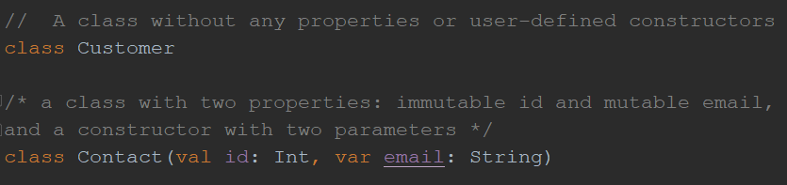
Classes and Constructors

Slide 48
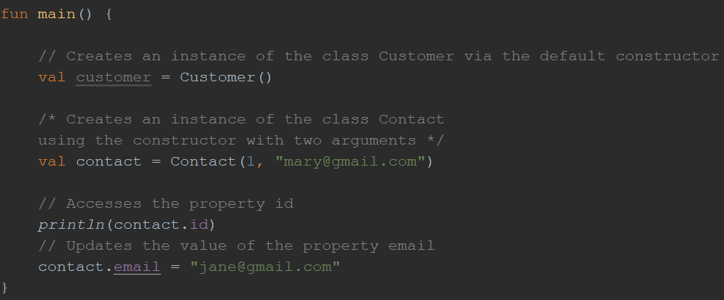
Classes and Constructors

Slide 49
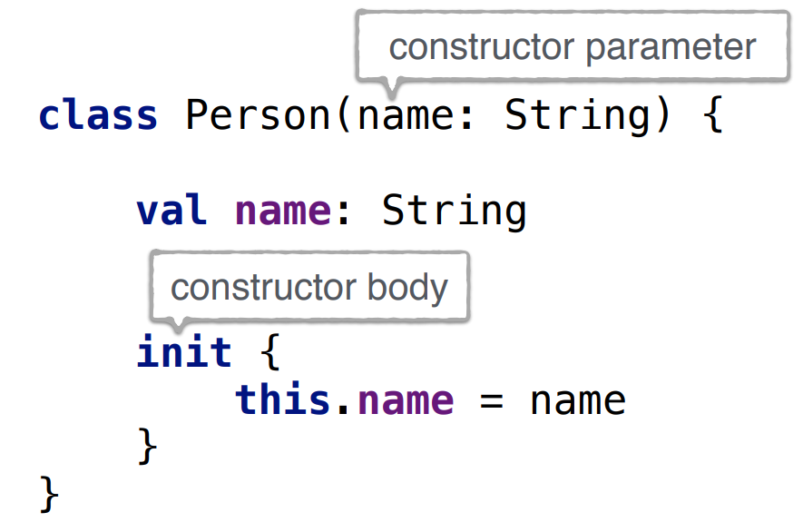
Classes and Constructors
Concise Primary Constructor
Full Constructor

Slide 50
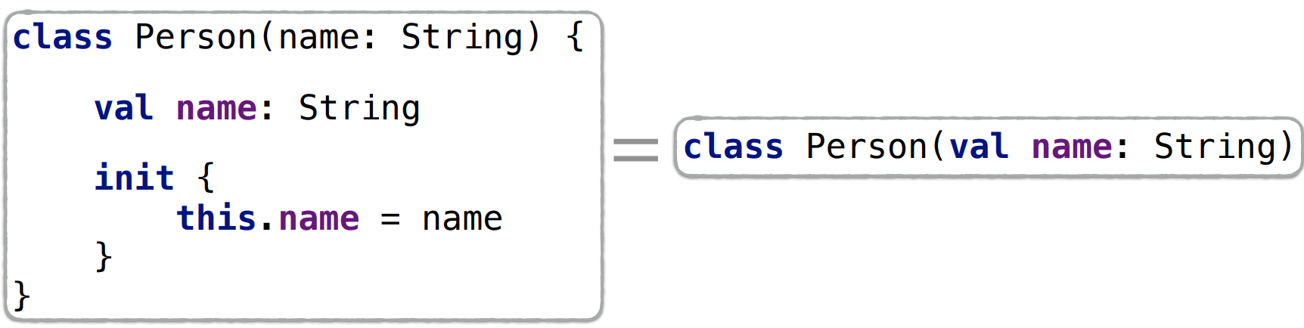
Classes and Constructors
val/var on a parameter creates a property

Slide 51
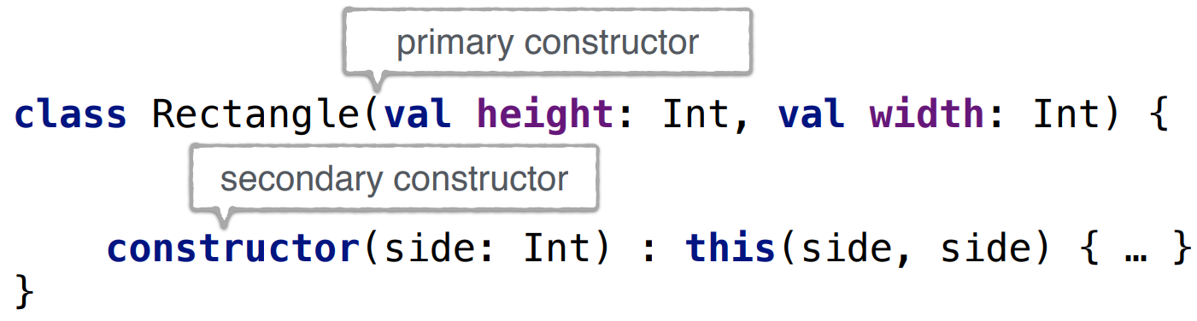
Classes and Constructors
Secondary Constructor
this(...) calls another constructor of the same class

Slide 52
Modifiers
final, open, abstract, override
public, private, internal, protected
Definition:
A module: a set of Kotlin files compiled together

Slide 53
Modifiers
final (used by default): cannot be overridden
open: can be overridden
abstract: must be overridden (can’t have an implementation)
override (mandatory): overrides a member in a superclass or interface

Slide 54
Modifiers
Modifier | Class Member | Top-level Declaration
public | Visible everywhere | Visible everywhere
internal | Visible in a module | Visible in a module
protected | Visible in a subclass | ---------------------
private | Visible in a class | Visible in a file

Slide 55
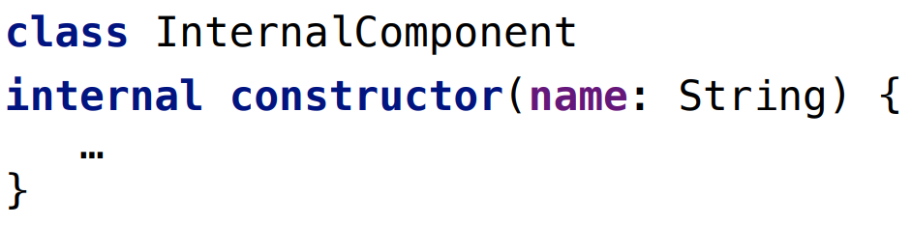
Change Visibility

Slide 56
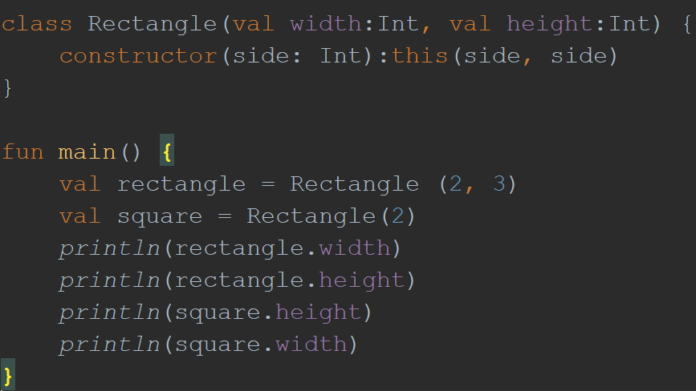
Example

Slide 57
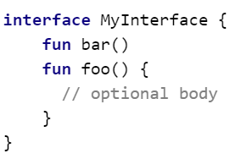
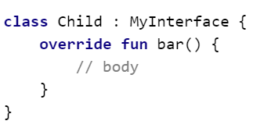
Interfaces and their Implementation

Slide 58
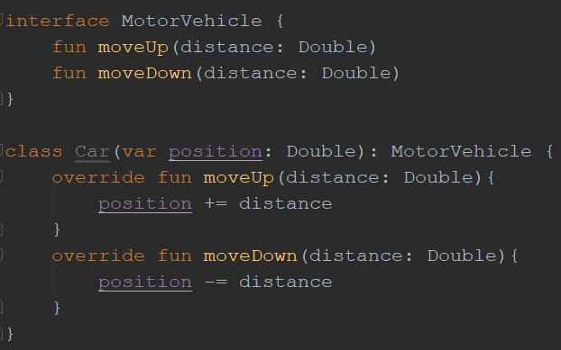
Interfaces Example

Slide 59
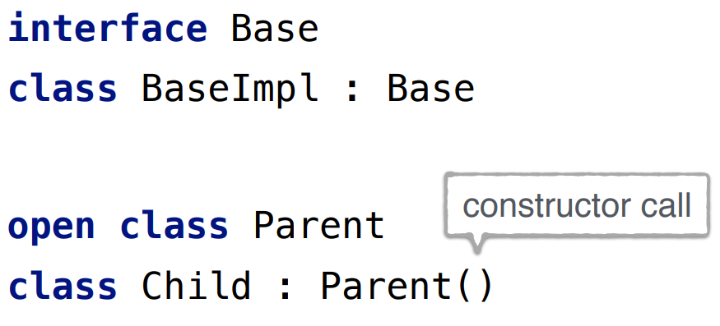
Inheritance
The same syntax can be used for extending a class & implementing an interface

Slide 60
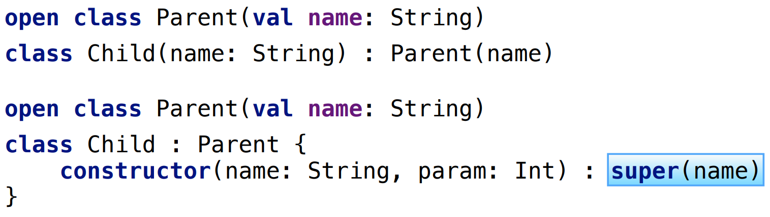
Inheritance
Calling a constructor of the parent class

Slide 61
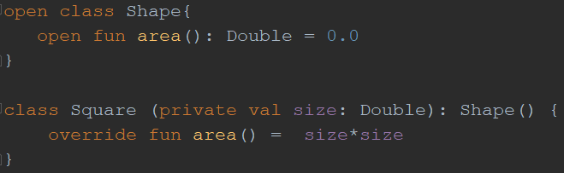

Inheritance Example

Slide 62

Properties
Properties = fields + accessors
Read Only Properties = fields + getters
Mutable Properties = fields + getters + setters

Slide 63

Properties
Properties = fields + accessors
Read Only Properties = fields + getters
Mutable Properties = fields + getters + setters

Slide 64

Properties
Custom getters

Slide 65

Properties
Private setters

Slide 66

Properties
Custom setters

Slide 67
Data Classes
Used for holding data
The compiler automatically derives members such as the following from all properties declared in the primary constructor
equals()/hashCode()
toString() of the form "User(name=Abebe, age=42)"
copy() function
Note that the compiler only uses the properties defined inside the primary constructor for the automatically generated functions

Slide 68
Data Classes
have to fulfill the following requirements:
The primary constructor needs to have at least one parameter
All primary constructor parameters need to be marked as val or var
Data classes cannot be abstract, open, sealed or inner

Slide 69

Data Classes: Copying

Slide 70

Enum Classes

Slide 71
Enum Classes

Slide 72
Enum Classes

Slide 73

Enum Classes (with properties and methods)

Slide 74

Enum Classes (with properties and methods)

Slide 75
Sealed Classes
Are used for representing restricted class hierarchies in which an object can only be of one of the given types
Are, in a sense, an extension of enum classes
can have subclasses, but all of them must be declared in the same file
A subclass of a sealed class can have multiple instances which can contain state

Slide 76
Sealed Classes
You can declare the subclasses inside the sealed class or outside but they always have to be declared in the same file.
Is abstract by itself, it cannot be instantiated directly and can have abstract members
Are not allowed to have non-private constructors (their constructors are private by default)

Slide 77

Sealed Classes: Example

Slide 78

Sealed Classes: Example

Slide 79

Object Declaration
With the object keyword, you specify that a class will be limited to a single instance – a singleton
A single Counter instance (object)

Slide 80

Object Declaration
With the object keyword, you specify that a class will be limited to a single instance – a singleton
A single Game instance (object)

Slide 81

Object Expressions
Replaces Java anonymous class

Slide 82

Object Expressions
Replaces Java anonymous class

Slide 83

Companion Object
It is an object that is common to all instances of that class.
It is similar to static fields in Java.

Slide 84
Part-IV
Lambda Expression
Operations on Collections
Nullability
Safe casts

Slide 85

Lambda Expression: Syntax

Slide 86

Lambda Expression: Example
Full Syntax

Slide 87

Lambda Expression: Example
When lambda is the last argument, it can be moved out of parenthesis

Slide 88

Lambda Expression: Example
Empty parenthesis can be omitted

Slide 89

Lambda Expression: Example
Data type can be omitted if it can be inferred

Slide 90

Lambda Expression: Example
For single arguments you can use the keyword it

Slide 91

Lambda Expression: Example
In multiline lambda, the last expression is the result

Slide 92

Lambda Expression: Example
Destructuring

Slide 93


Lambda Expression: Example
You can omit a parameter name if it is not used

Slide 94

Operations on Collections
filter

Slide 95

Operations on Collections
map

Slide 96

Operations on Collections
any (all, none)

Slide 97

Operations on Collections
find

Slide 98

Operations on Collections
first / firstOrNull

Slide 99
Operations on Collections
first / firstOrNull

Slide 100

Operations on Collections
count

Slide 101

Operations on Collections
partition

Slide 102

Operations on Collections
groupBy

Slide 103

Operations on Collections
associateBy

Slide 104

Operations on Collections
associateBy (removes duplicate)

Slide 105

Operations on Collections
zip

Slide 106

Operations on Collections
flatMap

Slide 107

Nullability: Nullable types in Kotlin
Kotlin makes Null Pointer Exception a compile-time error (not runtime error)

Slide 108

Nullability: Safe access

Slide 109

Nullability: Nullability operators

Slide 110

Nullability: Nullability operators

Slide 111

Safe casts: as

Slide 112

Safe casts: as?

Slide 113

Safe casts

Slide 114

Safe casts: as?

Slide 115


Standard Functions
apply
can be thought of as a configuration function
It allows you to call a series of functions on a receiver to configure it for use

Slide 116
References
https://play.kotlinlang.org/koans/overview
https://kotlinlang.org/docs/reference/
https://www.coursera.org/learn/kotlin-for-java-developers
Jemerov, Dmitry, and Svetlana Isakova. Kotlin in action. Shelter Island, NY: Manning Publications, 2017
Skeen, Josh, and David Greenhalgh. Kotlin programming : the Big Nerd Ranch guide. Atlanta, GA: Big Nerd Ranch, 2018
https://www.youtube.com/user/JetBrainsTV

